Slide 1
IE260 Lecture 1: Simple Sentiment Analysis
Il-Chul Moon
Department of Industrial and Systems Engineering
KAIST
icmoon@kaist.ac.kr

Slide 2
Short Recap

Slide 3
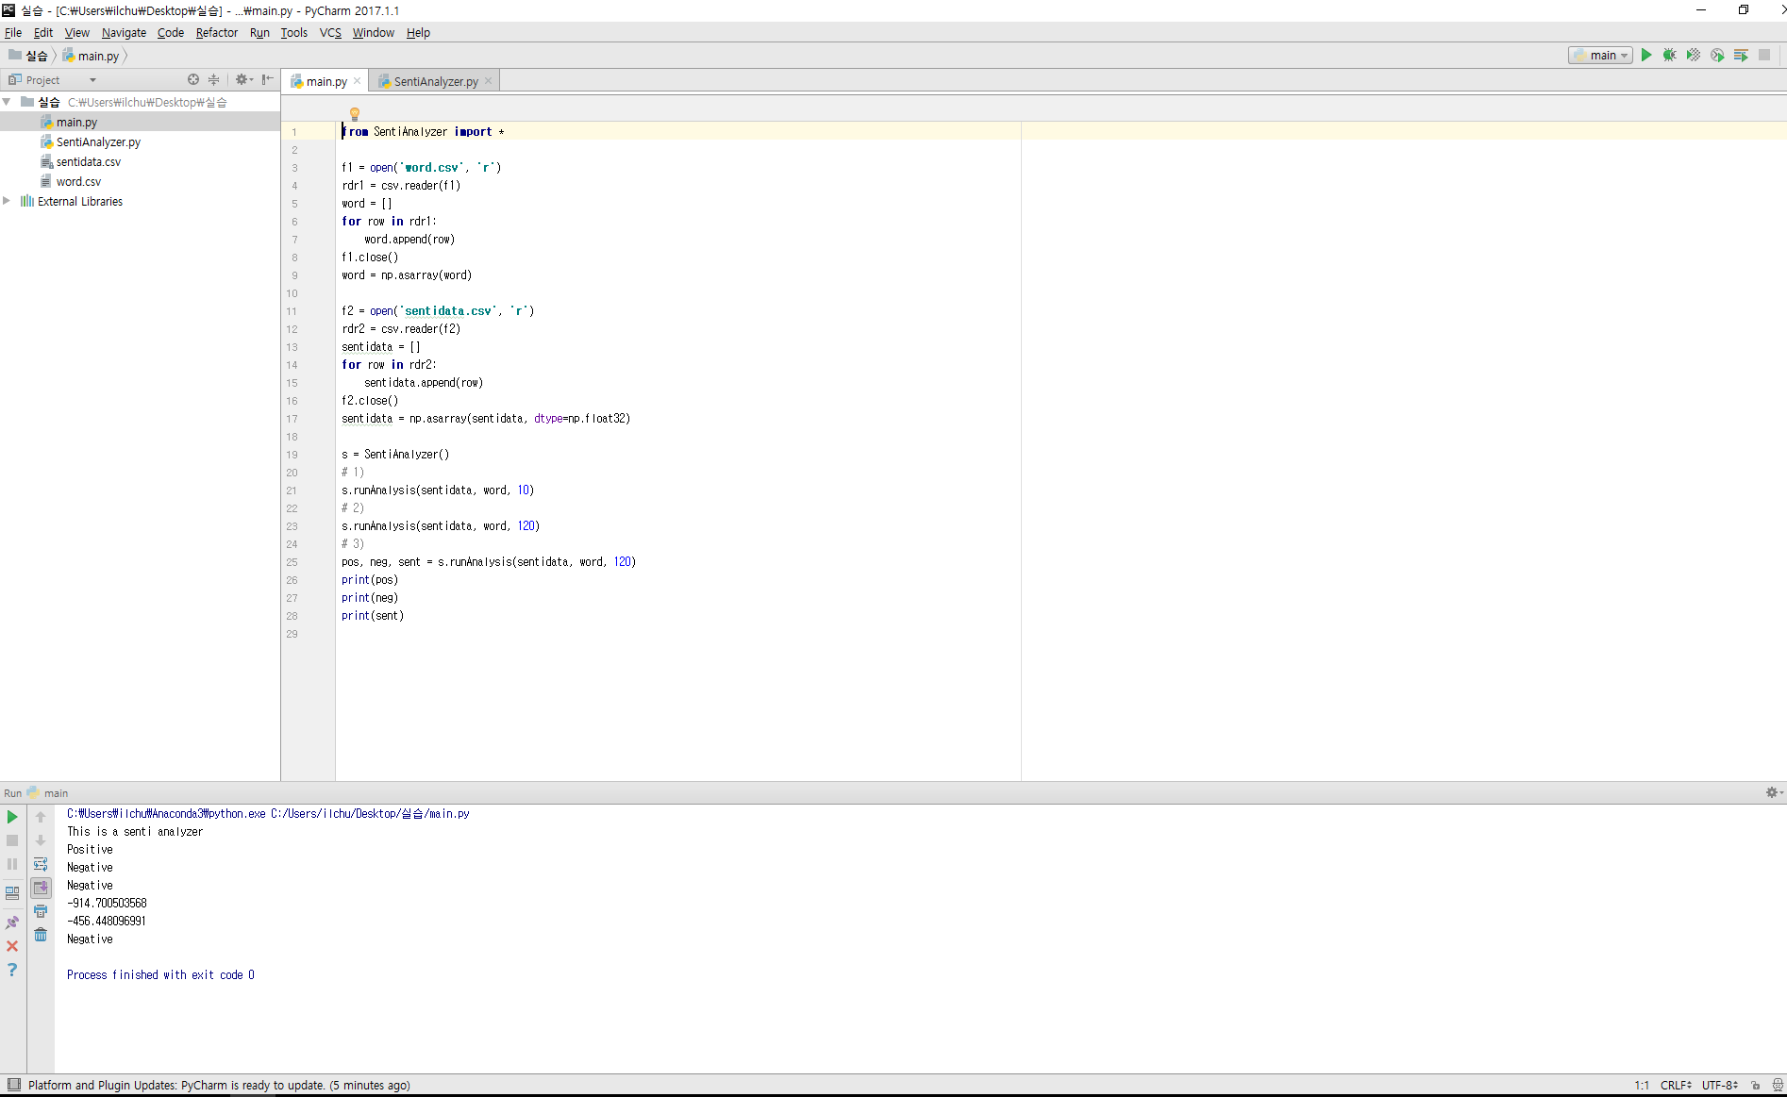
Programming Environment
Program File Lists
Execution Buttons
Code
Editor
Run Result

Slide 4
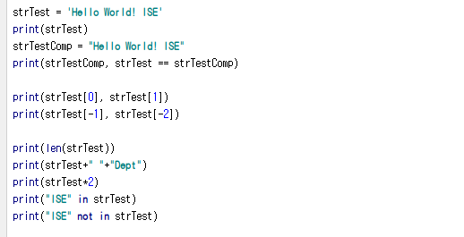
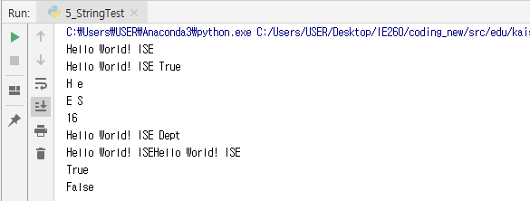
H | e | l | l | o |  | W | o | r | l | d | ! |  | I | S | E
0 | 1 | 2 | 3 | 4 | 5 | 6 | 7 | 8 | 9 | 10 | 11 | 12 | 13 | 14 | 15
 | -15 | -14 | -13 | -12 | -11 | -10 | -9 | -8 | -7 | -6 | -5 | -4 | -3 | -2 | -1
String
String variable statements
Both of ‘ and “ work as wrappers
String value equivalence test, quite simple!
See how the string operators work!
String variable is actually a linear collection of letters, and the letters have indexes
Existence check in collection variables

Slide 5
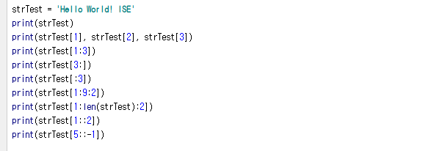
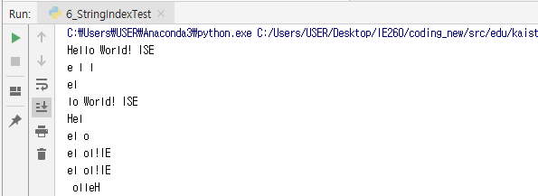
Index in Sequence
This index applies to strings
as well as tuples, lists
→ Applies to any sequence variables
Simple index of a sequence, or an array
x:y → from x to y
x:y:z → from x to y with z steps
Default:
y = the length of the sequence
z = 1

Slide 6
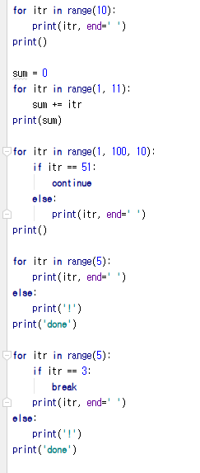
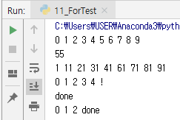
for
A loop statement
The most common loop statement in programming languages
for variable in sequence:
Statements for loop
else:
when for-loop is finished without a break
Some useful statements for loops
continue
break

Slide 7
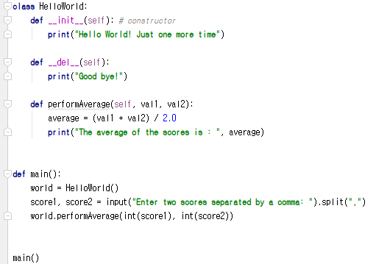
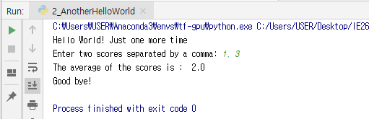
Python Program Structure – Another Hello World
Your second Python program in this class
Object-oriented program
HelloWorld is an object
__init__, __del__, and performAverage are methods
Largely in two parts
Definition part
Execution part

Slide 8




Additional Knowledge for Exercise (1)
sentidata = [ ]
for loop (sentidata.append(row))
Create a 2-D array
zip(v1,v2)
Call elementwise pair of vector v1 and v2

Slide 9



Additional Knowledge for Exercise (2)
enumerate(list)
Call index and value together
sum(list)
Sum of list

Slide 10
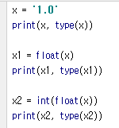

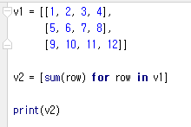
Additional Knowledge for Exercise (3)
int(float(x))
Convert a string type x into integer type
List comprehension
Make a list of value that satisfies the condition
list = [value for loop (condition)]

Slide 11
Offline Class Plan

Slide 12

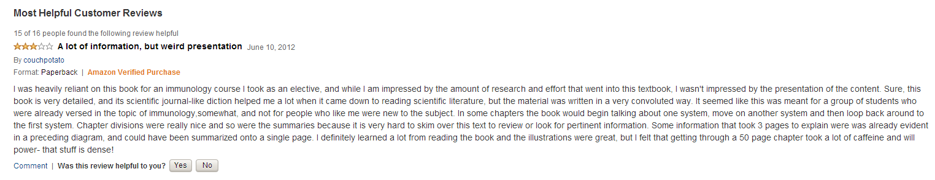
Product Review and Sentiment Analysis
Amazon
Product information
Also, product review
Product review
Some are positive
Some are negative
What-if we have 10,000 reviews and want to find the negative ones?

Slide 13




Why simple word searching doesn’t work
There are universal good and bad words
Excellent, good, super…
Horrible, worst, never…
How about this?
Cool?
Cool Beer
Hot?
Hot Pizza
Big?
Big LCD
Small?
Small Size
Searching and counting → Probabilistic approach

Slide 14
Bag of Words
For statistical analyses
We turned the review text into a vector
A vector <1,0,0,1>
A word list <I, cool, lcd, reliant>
Together,
The review contains words: “I” and “reliant”

Slide 15
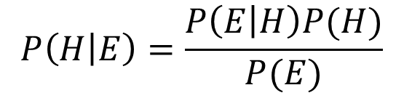
Conditional Probability and Bayes Theorem
Let’s observe word “actually” and “positive” review
Hypothesis (H): Review is something that we want to know
Evidence (E): Word is something that we can observe
What you just found out is
P(E=“actually” | H=“positive”) = P(H=“positive” and E=“actually”) / P(H=“positive”)
Our what-if question is
We know E, we don’t know H, can we find out H with E?
Then what we need is P(H|E), not P(E|H)
What can we do?
$$P\left(H | E\right)=\frac{P\left(E | H\right)P(H)}{P(E)}$$

Slide 16
Product Review and Sentiment Analysis
Amazon
Product information
Also, product review
Product review
Some are positive
Some are negative
What-if we have 10,000 reviews and want to find the negative ones?
Bayes theorem
E: observation of a word
H: sentiment label
Given E, we want to know H
But what if we have many words?
$$P\left(H | E\right)=\frac{P\left(E | H\right)P(H)}{P(E)}$$

Slide 17
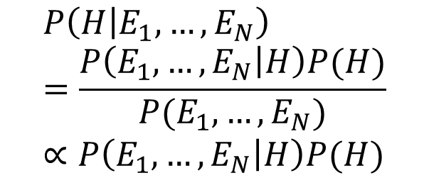
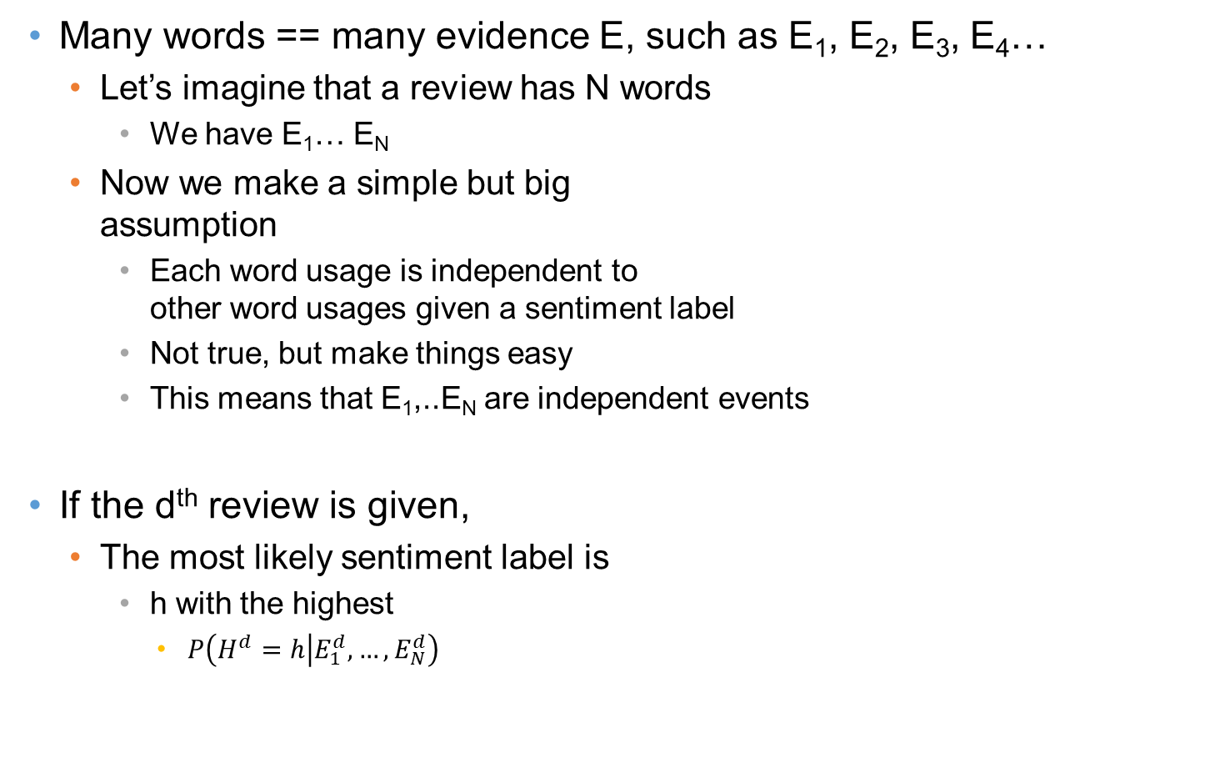
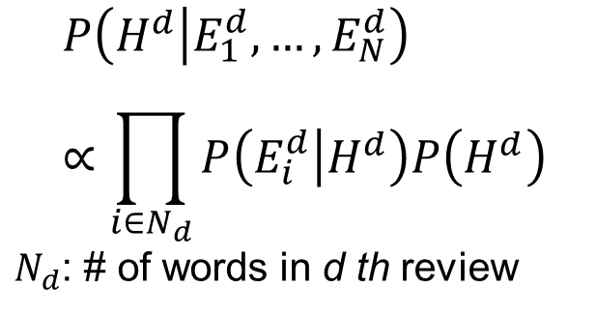
Many Words
Many words == many evidence E, such as E₁, E₂, E₃, E₄…
Let’s imagine that a review has N words
We have E₁… E_{N}
Now we make a simple but big assumption
Each word usage is independent to other word usages given a sentiment label
Not true, but make things easy
This means that E₁,..E_{N} are independent events
If the d^{th} review is given,
The most likely sentiment label is
h with the highest
$P\left(H^{d}=h | E_{1}^{d},…,E_{N}^{d}\right)$
$$P\left(H | E_{1},…,E_{N}\right)=\frac{P\left(E_{1},…,E_{N} | H\right)P(H)}{P(E_{1},…,E_{N})} \\ ∝P\left(E_{1},…,E_{N} | H\right)P(H)$$
$$P\left(H^{d} | E_{1}^{d},…,E_{N}^{d}\right)∝\prod_{i∈N_{d}}{P\left(E_{i}^{d} | H^{d}\right)P\left(H^{d}\right)}$$ $N_{d}$: # of words in d th review

Slide 18
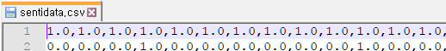
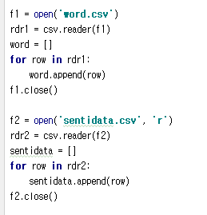
Dataset
Locate your folder where you downloaded .csv file
Open the file with the text editor
‘main.py’ opens the dataset in Python
word.csv
sentidata.csv
See what it stores
sentidata
Row: 198 product reviews
Col:
0-28624: whether the review contains a certain word (1) or not (0)
28625: whether the review is positive (1) or not (0)
words
Row: 28624 words

Slide 19
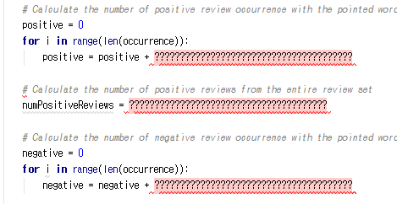
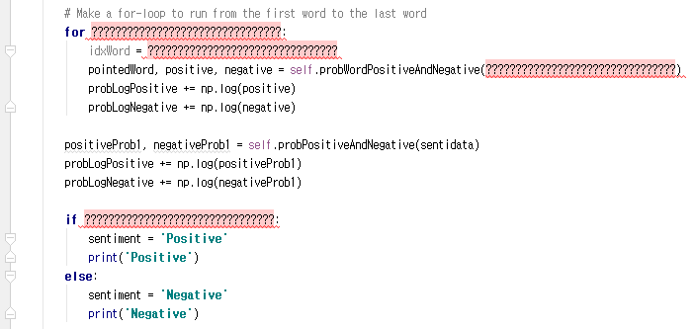
Tasks
Complete the below codes in ‘SentiAnalyzer.py’
You can run the program with ‘main.py’

Slide 20
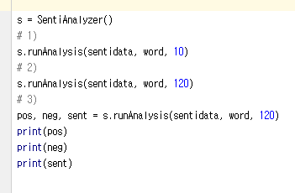
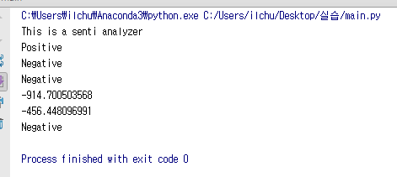
Expected Result
main.py
Runs the codes in the SentiAnalyzer.py
Why
Pos, neg are negative values?
Why use logs?
Expected Resuls

Slide 21

Announcement
Download python via Anaconda
We will use numpy library from next class
Search ‘python anaconda’ and download Python 3.6 version

Slide 22
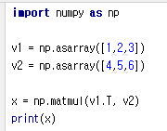
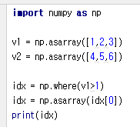
Announcement
Download python via Anaconda
We will use numpy library from next class
There are many convenient functions provided by numpy
Matrix multiplication
Find index of list with condition

